Slide 1
Machine learning to improve productivity employees rating in software company
                GROUP MEMBERS
                SARAKANAM MANOJ KUMAR 700741915
                DEVI SATYASRI GUNDUMOGULA 700742085
                NUTULAPATI PRAVEEN KUMAR 700742048
                VENKATA MALAKONDA PRUDHVI TANIKONDA - 700742630

Slide 2
Roles and Responsibilities
Manoj and Satya have spent time evaluating and deciding machine learning algorithms by referring to various papers and articles
Praveen and prudhvi oversaw data collection preprocessing RFC algorithm and ML model implementation

Slide 3
Motivation:
Once configured, the software continuously monitors any data trails that a corporation can make available for
each of its employees in the background.
The system learns the normal workflow for different workers by using machine learning algorithms.
The software assigns each employee a "productivity score" and it has determined their regular pattern of
behaviour.
Even if employees in a corporation perform various tasks, their ratings can still be compared. A productivity
score also shows whether employee effort boosts or depletes productivity.

Slide 4
Objectives:
The objective of the project is to improve the productivity of the company by anlyzing the employee ratings.
The dataset containing the employee rating will be taken into consideration and the pre-processing will be applied in to the dataset, and the noisy and null value data will be removed from the dataset.
After the data will be analyzed and visualized for further processing. The machine learning algorithm will be choosed to make the analysis.
The application will be develoepd with Google Colab Python Tool as the project can be directly executed in any type computer systems with internet connection.

Slide 5
Related work
An organization will suffer various negative effects from high performance.
It might be challenging to replace employees with specific skill set or industry experts.
Current staff productivity and ongoing research are both impacted
To give them a perspective for operation, organizations solve this problem by using machine learning approaches to forecast result

Slide 6
Problem statement
Since employee performance has a detrimental impact on operational productivity and long-term evolution objectives, it has been recognized as crucial issue for business.
In order to anticipate workplace efficiency, businesses apply machine learning algorithms to address this issue.

Slide 7
Problem solution
t.
It will begin from the principal segment and investigate every section and comprehend what influence it makes on the objective segment.
At the necessary step, we will likewise perform preprocessing and include designing undertakings.
The point in acting top to bottom exploratory examination is to get ready and clean information for better machine learning demonstrating to accomplish elite execution and summed up models.

Slide 8
It should begin with breaking down and setting up the dataset for expectation.
Modules:
1) Dataset collection
2) Data cleaning
3) Exploratory Data Analysis
4) Machine learning Modeling
5) Report

Slide 9
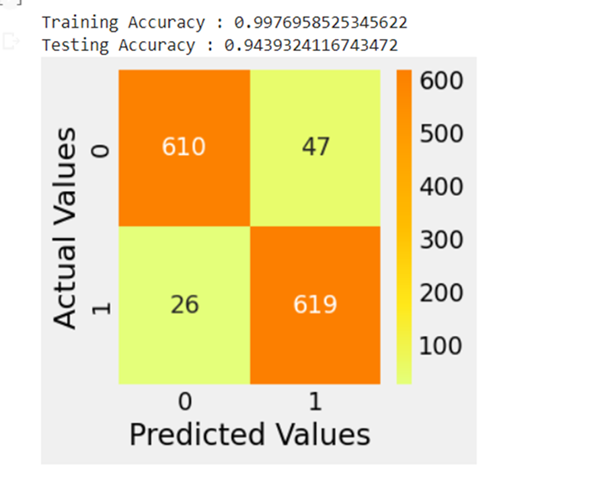
Results
Training accuracy is 0.997695852534
Testing accuracy is 0.9439324116743

Slide 10
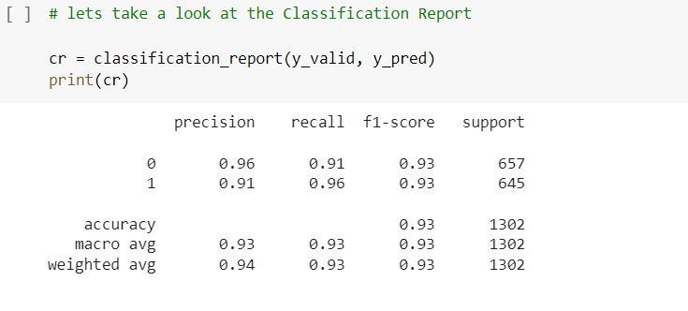
Classification report
The classification report displays the accuracy, precision, recall, f1 score and support.

Slide 11
References:
Kevser Şahinbaş, " Employee Promotion Prediction by using Machine Learning Algorithms for Imbalanced Datase ", n September
14,2022 at from IEEE Xplore©2022 IEEE.
Jung-gu Choi1*, Inhwan Ko2*, Jeongjae Kim1, Yeseul Jeon3, and Sanghoon Han1,2, " Machine Learning Framework for Multi
-level Classification of Company Revenue", IEEE 2021.
P. Choudhury, C. Foroughi and B. Larson, "Work- from- anywhere: The productivity effects of geographic flexibility", Strategic
Management Journal, vol. 42, no. 4, pp. 655-683, 2021.
Richard Josep, Shreyas Udupa and Sanket Jangale, "Employee Attrition Using Machine Learning And Depression Analysis ", 978-
0-7381-1327-2/21/$31.00 ©2021 IEEE.
B. Becker, B. Gerhart, “The Impact of Human Resource Management on Organizational Performance: Progress and Prospects,”
Academy of Management Journal, vol. 39, no. 4, pp.779–801, Aug. 1996.

Slide 12

Thank you

